Slide 1
Time Series Forecasting
Python

Slide 2
Time Series Forecasting
A Time Series is defined as a series of data points recorded at different time intervals. The time order can be daily, monthly, or even yearly.
Time Series forecasting is the process of using a statistical model to predict future values of a time series based on past results.
Forecasting is the step where we want to predict the future values the series is going to take.
Forecasting a time series is often of tremendous commercial value.

Slide 3
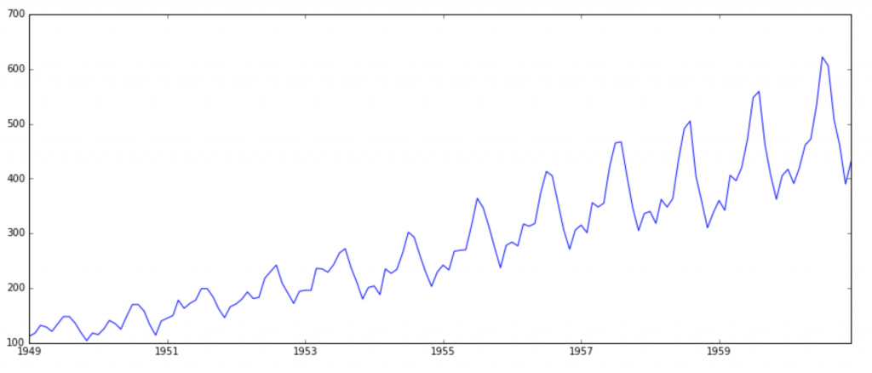
Time Series Forecasting
There are 2 major reasons behind non-stationarity of a Time Series:
1. Trend – varying mean over time. For eg., in this case we saw that on average, the number of passengers was growing over time.
2. Seasonality – variations at specific time-frames. eg people might have a tendency to buy cars in a particular month because of pay increment or festivals.

Slide 4
ARIMA (autoregressive integrated moving average) Model
Model Identification. Use plots and summary statistics to identify trends, seasonality, and auto-regression elements to get an idea of the amount of differencing and the size of the lag that will be required.
Parameter Estimation. Use a fitting procedure to find the coefficients of the regression model.
Model Checking. Use plots and statistical tests of the residual errors to determine the amount and type of temporal structure not captured by the model.

Slide 5
ARIMA
AR(p) Autoregression – a regression model that utilizes the dependent relationship between a current observation and observations over a previous period. An auto regressive (AR(p)) component refers to the use of past values in the regression equation for the time series.
I(d) Integration – uses differencing of observations (subtracting an observation from observation at the previous time step) in order to make the time series stationary. Differencing involves the subtraction of the current values of a series with its previous values d number of times.
MA(q) Moving Average – a model that uses the dependency between an observation and a residual error from a moving average model applied to lagged observations. A moving average component depicts the error of the model as a combination of previous error terms. The order q represents the number of terms to be included in the model.

Slide 6
ARIMA PARAMETERS
The parameters of the ARIMA model are defined as follows:
p: The number of lag observations included in the model, also called the lag order.
d: The number of times that the raw observations are differenced, also called the degree of differencing.
q: The size of the moving average window, also called the order of moving average.

Slide 7
SARIMA
Seasonal Autoregressive Integrated Moving Average, SARIMA or Seasonal ARIMA, is an extension of ARIMA that explicitly supports time series data with a seasonal component
It adds three new hyperparameters to specify the autoregression (AR), differencing (I) and moving average (MA) for the seasonal component of the series, as well as an additional parameter for the period of the seasonality.

Slide 8
Configuring SARIMA
Trend Elements
p: Trend autoregression order.
d: Trend difference order.
q: Trend moving average order.
Seasonal Elements
There are four seasonal elements that are not part of ARIMA that must be configured:
P: Seasonal autoregressive order.
D: Seasonal difference order.
Q: Seasonal moving average order.
m: The number of time steps for a single seasonal period.

Slide 9
Loading SARMIA model
from statsmodels.tsa import seasonal,arima_model
import statsmodels.api as st
st.tsa.statespace.SARIMAX(tm,order=(0,1,1),seasonal_order=(1,1,1,12))
fit()
forecast()

